Slide 1
Sensors
FeMaidens Programming 2017-2018
Lily and Marisa

Slide 2
What are sensors?
Sensors are devices that measure, output and sometimes respond to information about the position (or other characteristics) of the robot that we can use when driving or using the robot!
Many different sensors output different types of useful information
Some examples of sensors that we use are:
Encoders
Gyro
Ultrasonic
Camera

Slide 3
Encoders
Main purpose: To measure the distance that the robot has driven based on how much the wheels have moved
How they work: Encoders measure distance in terms of ticks, which are converted into usable information like this
While the robot is moving, the encoder gives us the number of ticks that it has measured
Each revolution (full turn) of a wheel is equal to a certain number of ticks
By dividing the number of ticks (that the encoder recorded), by the ticksPerRev, you get the number of turns that the wheel has made
Then, multiply the # of turns made by the wheel * the circumference (in usable units), to get the total distance travelled

Slide 4
Encoders (Cont.)
Ticks turned
X
Circumference of wheel
Ticks in one revolution

Slide 5
Gyro
Main purpose: To measure the degrees that the robot has turned over a certain period of time, which can help us align the robot
How they work:
Important Functions:
getRate() - returns the rate of rotation
getAngle() - returns the angle that the robot is currently facing
reset() - resets the gyro value to 0 → used to recalibrate, used in initialize
To make the robot drive straight, we compared the angle that the robot was facing to the angle that the robot is currently facing, and then set the left or right motors accordingly

Slide 6
Ultrasonic Sensors
Main purpose: To measure the distance to object and any obstruction (like echo-location that whales/bats use)
How they work:
A high-frequency sound wave is sent out from the sensor
The sound wave will continue moving forward until it hits something
The sound wave will bounce back from the object it hit. It will then reenter the sensor
The sensor then calculates the distance between the sensor and the obstruction

Slide 7
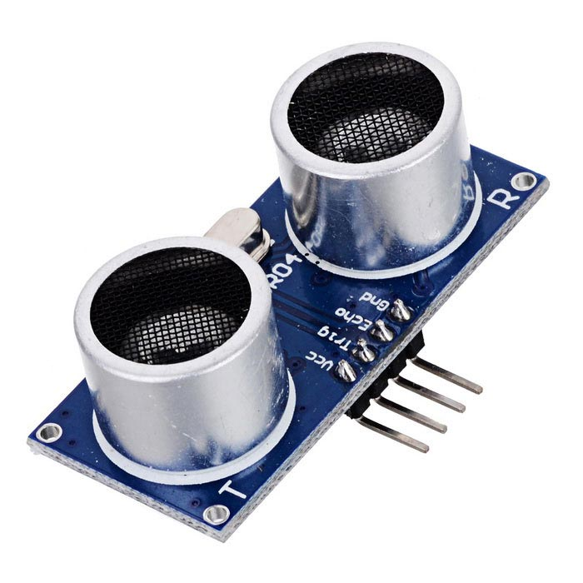
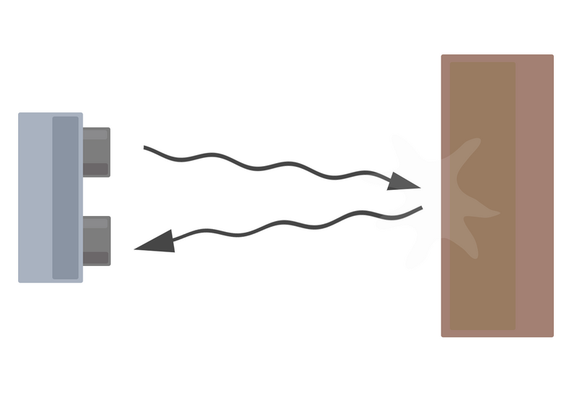
Ultrasonic (con’t)

Slide 8
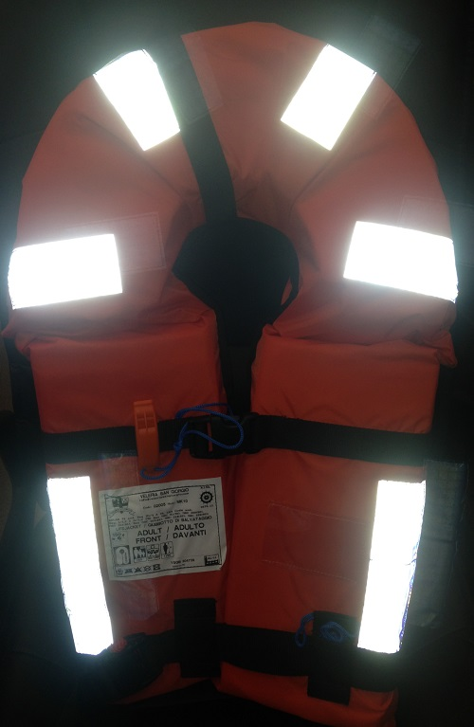
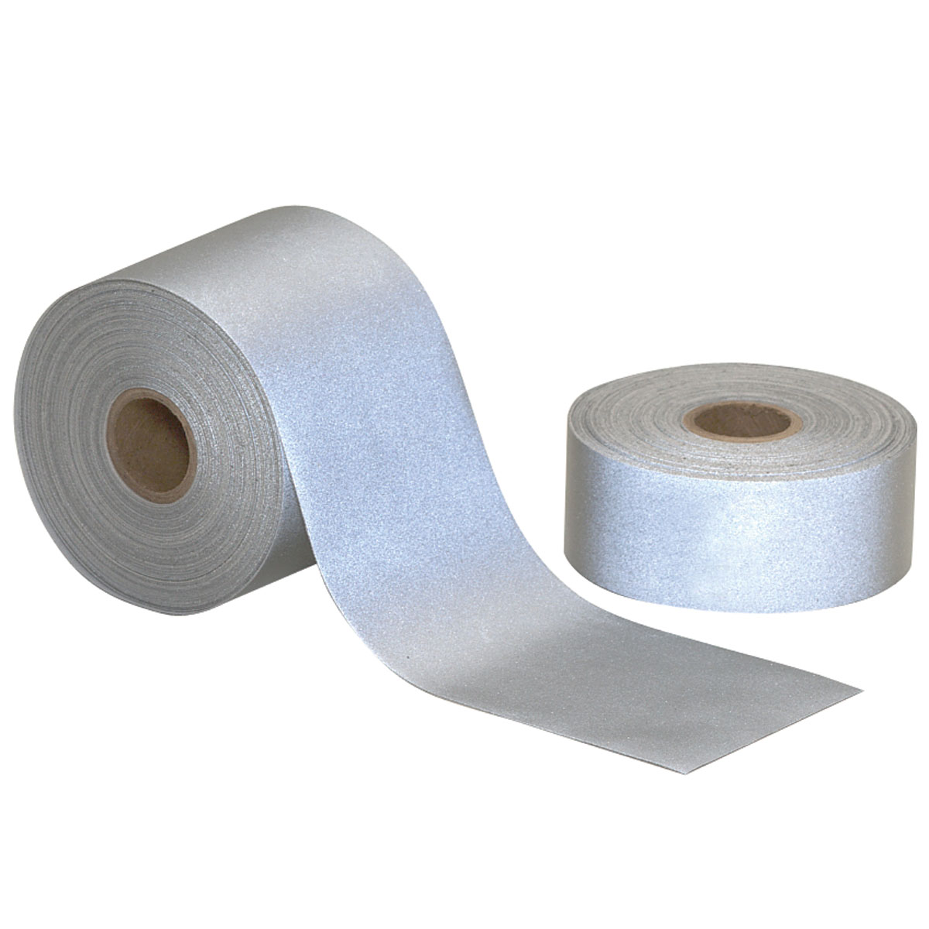
Camera
Main purpose: When attached to the robot, it can be used to have a better view of field objects (video is “live- streamed” on computer). This helps us target specific objects.
Notes:
Talk about retroreflective tape

Slide 9
Camera (Cont.)
How they work:
A library called OpenCV is used to isolate/get info from the desired objects (ex: retroreflective tape)
A light is directed towards the retroreflective tape (green light usually)
The tape becomes illuminated with the color of the light directed at it
The image from the camera is blurred
The specific shape and color the tape is used to target the desired object

